Slide 1
Medical Imaging
CSCI 4150/6050: Computer Vision

Slide 2
What makes medical imaging different?
Purpose: Trying to capture structure in order to make a diagnosis.
Acquisition: Non-standard cameras and scanning devices (MRI, X-ray, ultrasound, CT Scans, etc.)
Representation: Can have higher precision channels (e.g. 12-bit grayscale), massive resolutions (e.g. 100,000x100,000 histology images), 3D z-stacks, or temporal/longitudinal information.

Slide 3
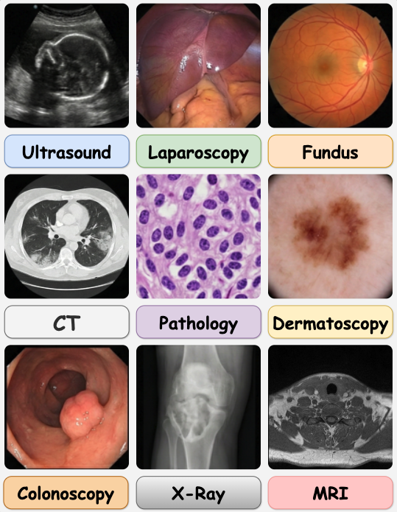
Examples of Medical Images
https://chongcongjiang.github.io/MedicalSAM3/

Slide 4
The Medical Imaging Pipeline
Signal Acquisition
Preprocessing/Denoising/Reconstruction
Analysis
We’ll focus on this step
Clinical Diagnosis

Slide 5
Medical Image Analysis
The purpose of medical image analysis is to automatically highlight or measure properties that are needed to make an informed medical diagnosis.
While there are many kinds of analyses, we go over two common ones that build directly on techniques you have learned so far.
Segmentation and Structure Analysis: Highlighting a region of interest and measuring properties about it.
Image Registration: Aligning multiple scan types or timepoints to each other for multimodal analysis.

Slide 6
Let’s start with segmentation and structure analysis…
How do you get a segmentation for a region of interest?

Slide 7
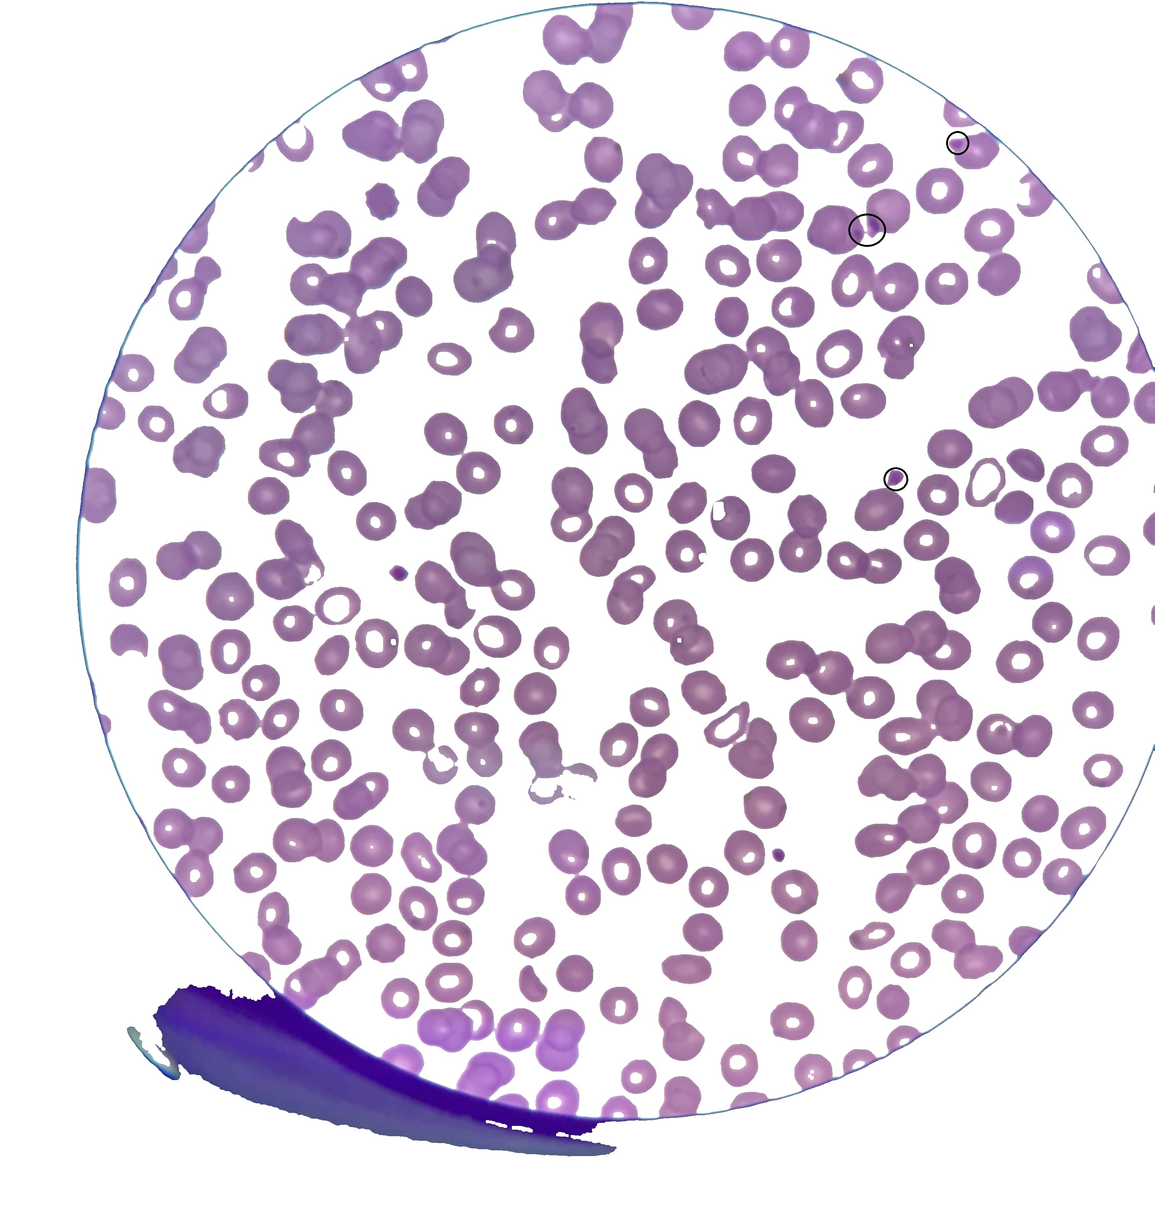
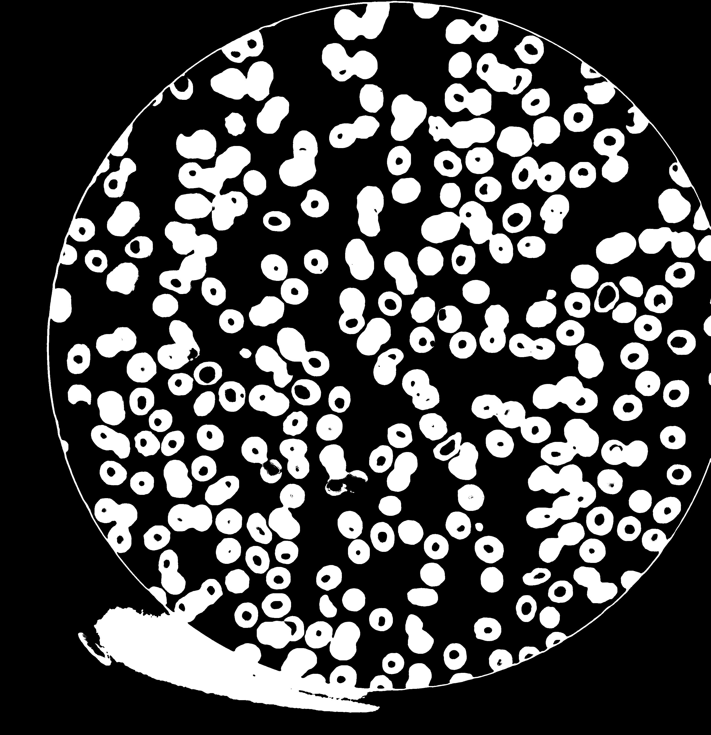
Connected Components
Very simple segmentation technique, often used for microscopy data.
Key Idea: Threshold the entire image. Any set of connected pixels is the same object.
https://answers.opencv.org/question/230252/separating-conjoined-blobs/

Slide 8
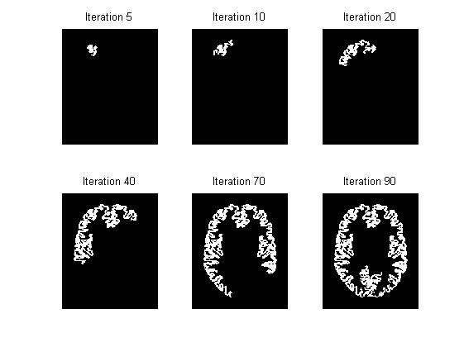
Variation: Region Growing
Same idea as connected components, but iteratively add adjacent pixels if they are “close enough” in color to the original seed color.
Also known as the “Magic Wand” tool in Photoshop and other programs.
Problems:
  Stopping prematurely
  Leaking through weak boundaries

Slide 9
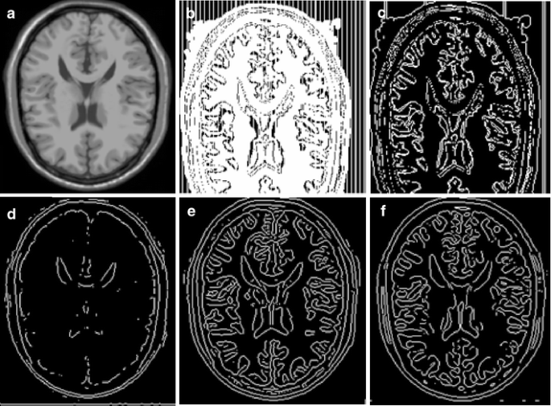
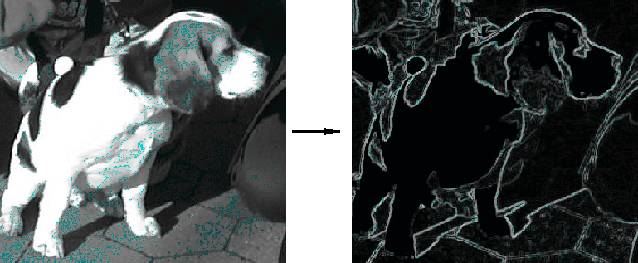
Edge-Based Segmentation
Core idea: Find continuous circuits of edges. Pixels within the circuit are part of the same object.
Pros
  Intuitive
  Still used in medical imaging
Cons
  Prone to errors
  Older idea that is often beaten by modern techniques
https://link.springer.com/article/10.1007/s11265-008-0200-z
https://medium.com/@1marcusangella/mastering-the-art-of-image-segmentation-a-comprehensive-guide-to-image-segmentation-techniques-545a75010a35

Slide 10
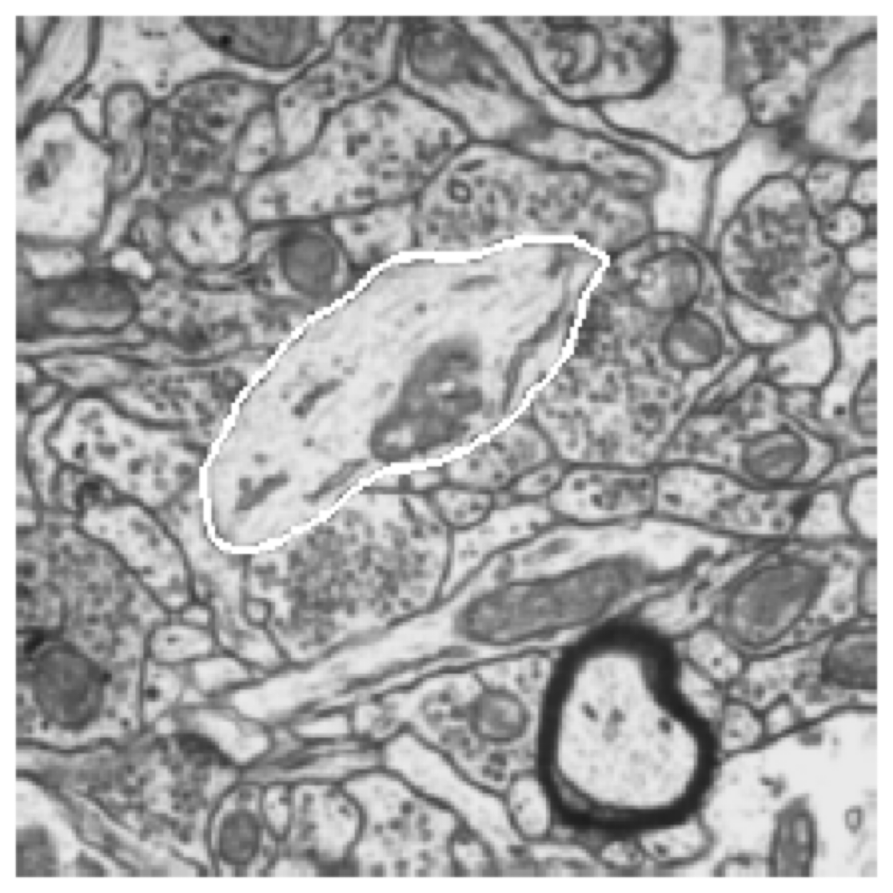
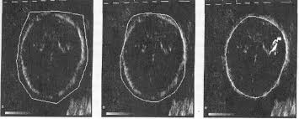
Active Contours (“Snakes”)
Key idea: a curve that adapts to fit the object’s edge
Goals:
  position should align well with the image’s edges
  the curve should stay smooth
Usually solved using gradient-descent optimization from a starting curve
As the parameters of the curve are iteratively optimized, the curve moves to fit the shape
  Nickname = “snakes”
Fitting image!
Prior!

Slide 12
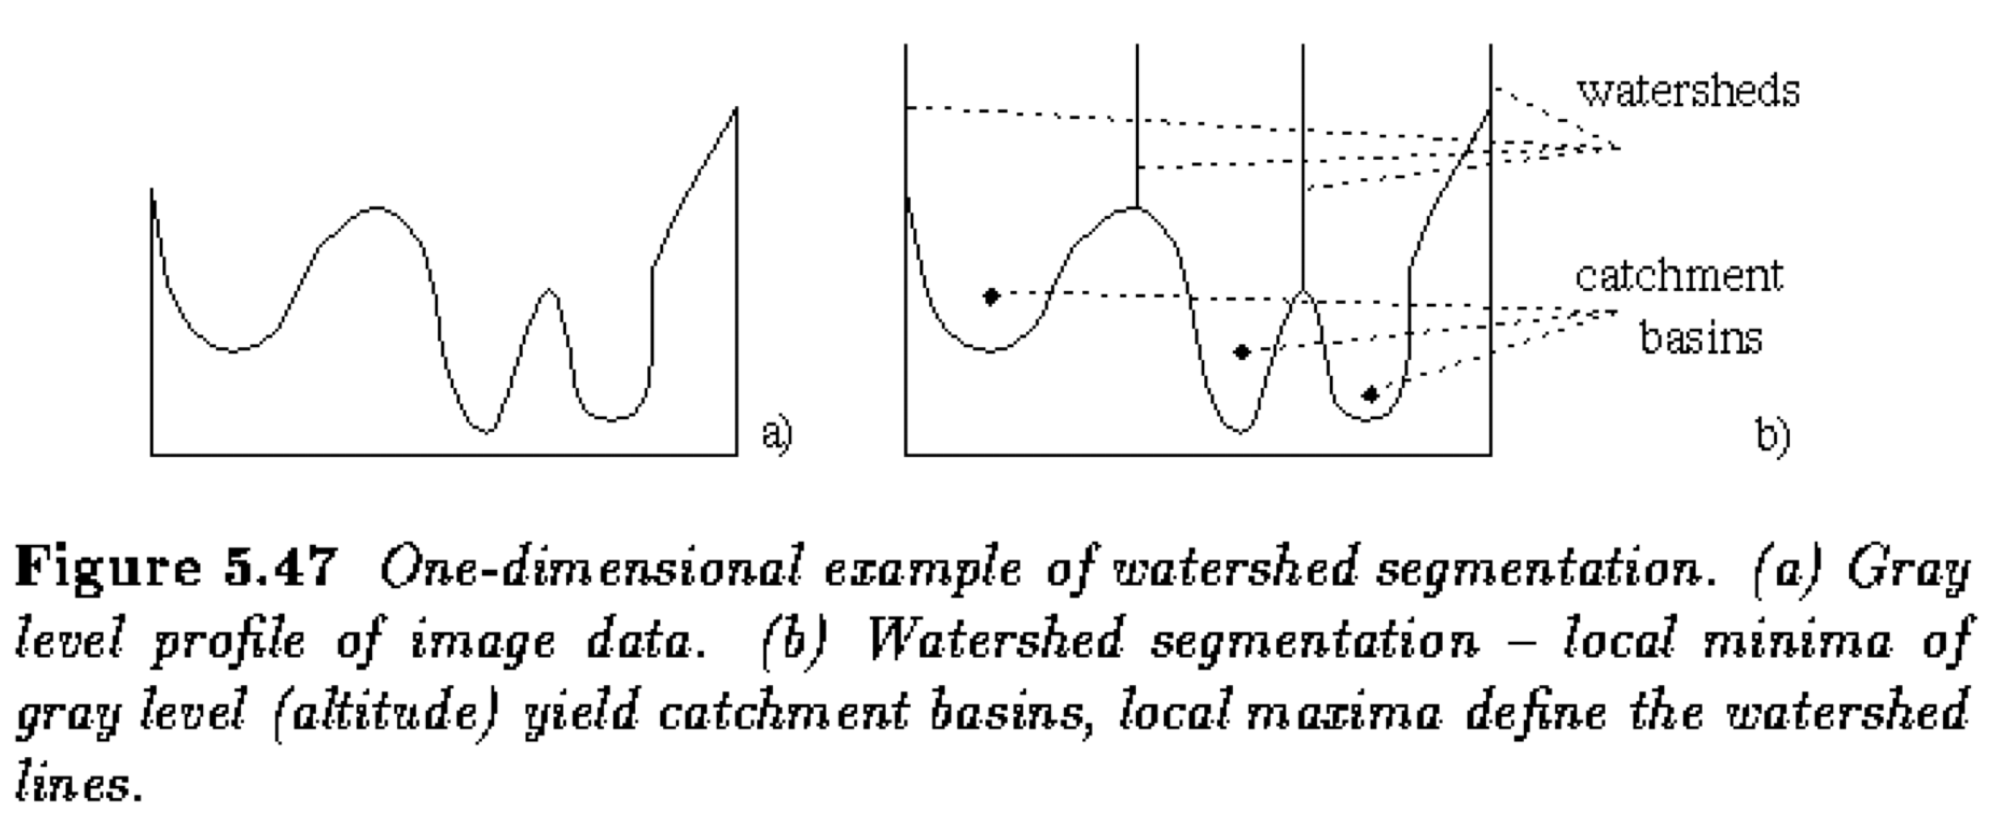
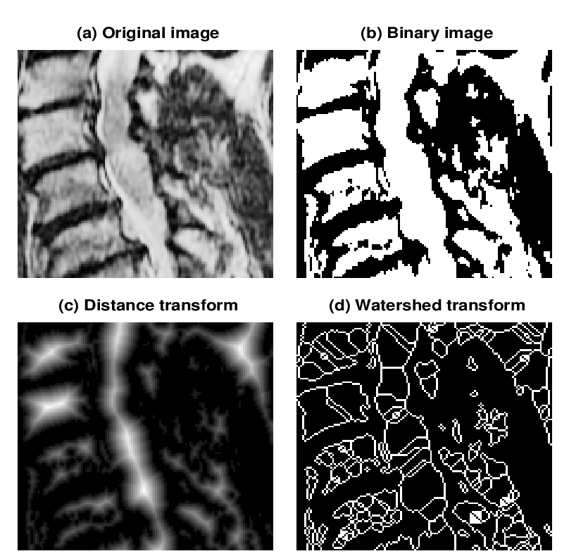
Gradient Watersheds
A “watershed” or “catchment basis” is a region over which all water flows downhill to a common destination
Core idea of watershed segmentation:
  Build a gradient-magnitude image
  Compute watershed regions
  (lots of efficient algorithms)
Can smooth the original/gradient image first to reduce noise / produce larger regions
https://www.researchgate.net/figure/The-segmentation-technique-starts-from-a-real-biomedical-image-which-is-converted-by_fig3_228453305

Slide 13
Once you have a segmentation, what do you do with it?

Slide 14

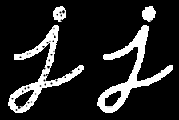
Morphology
Opening Example
Segmentations are usually noisy, so morphology operations can help clean up the mask.
  Dilate – Increase the mask size by k pixels at each border.
  Erode - Decrease the mask size by k pixels at each border.
  Open – Erode the mask, then dilate it (removes specs in the mask)
  Close – Dilate the mask, then erode it (removes holes in the mask)
Closing Example
https://docs.opencv.org/4.13.0/d9/d61/tutorial_py_morphological_ops.html

Slide 15
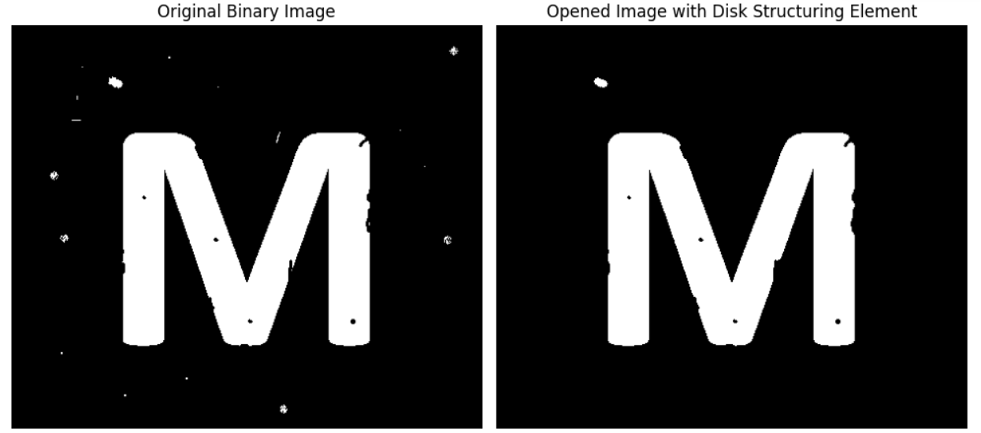
Morphology

Slide 16
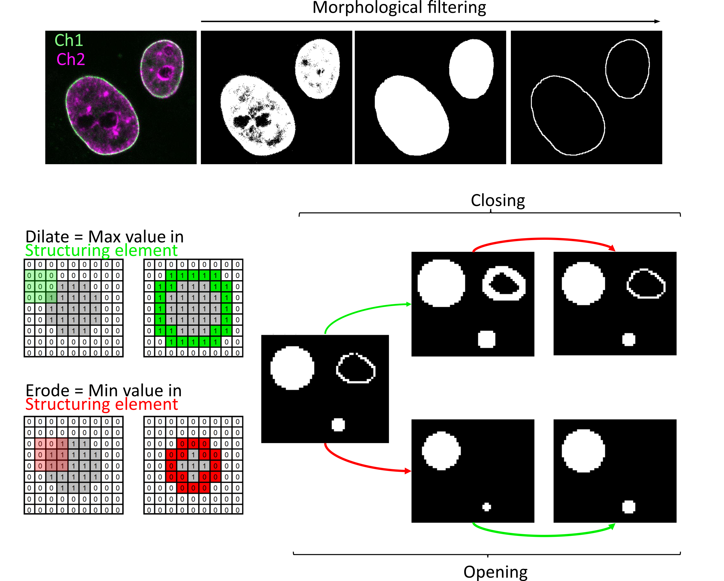
https://neubias.github.io/training-resources/filter_morphological/index.html

Slide 17
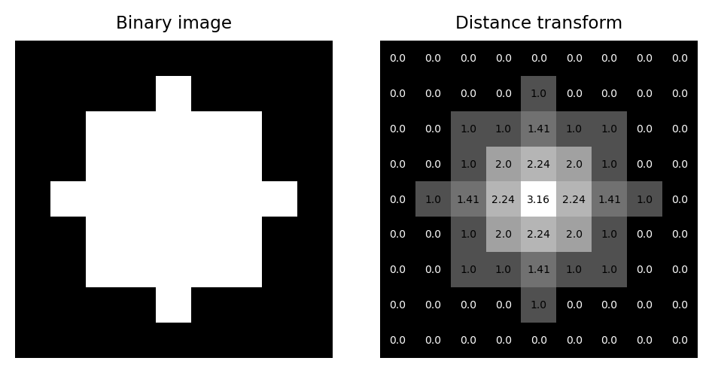
Mask Properties and
The Distance Transform
The mask of region has many properties that can be directly measured.
  Examples: Area, Eccentricity, Bounding Box
A common operation on the mask is the distance transform, which computes the distance of any pixel in the mask to the closest border.
  This helpful for measuring the width of particular sections of a mask.
https://bioimagebook.github.io/chapters/2-processing/6-transforms/transforms.html

Slide 18
Distance Transform
Image
Segmentation
Distance Transform
https://www.researchgate.net/figure/The-segmentation-technique-starts-from-a-real-biomedical-image-which-is-converted-by_fig3_228453305

Slide 19
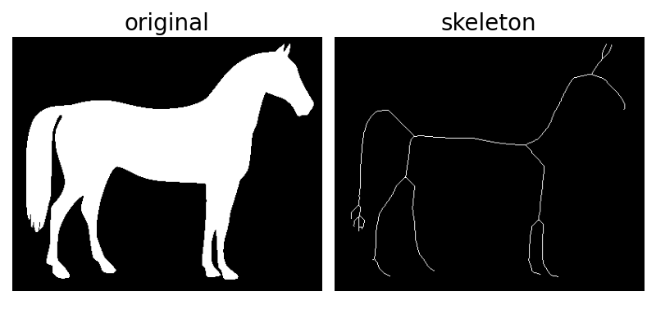
Skeletonization
Skeletonization is the process of finding a 1-pixel-wide path through a mask that represents its underlying structure.
It generally operates on the distance transform output to find the path of pixels furthest from the border.
This skeleton has many properties that can be measured such as total length, curvature, number of connections, etc.

Slide 20
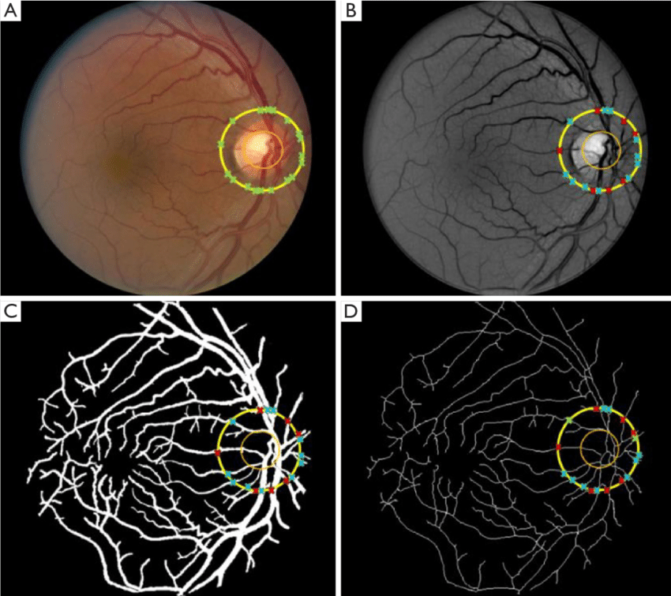
Skeletonization
https://www.researchgate.net/figure/Blood-vessel-segmentation-and-skeletonization-A-Color-fundus-image-B-enhanced-green_fig1_343655184

Slide 21
Let’s see it in Python…

Slide 22
OpenCV Functions
optimal_thresh, thresh_image = cv2.threshold( blurred_image, 0, 255, cv2.THRESH_BINARY + cv2.THRESH_OTSU )
  Finds the global optimal threshold and returns the thresholded image
num_labels, labels, stats, centroids = cv2.connectedComponentsWithStats(thresh_image)
  Given a thresholded image, returns all connected component regions, their centroids, and statistics such as area and bounding box.
contours, hierarchy = cv2.findContours(thresh, cv2.RETR_TREE, cv2.CHAIN_APPROX_SIMPLE)
  Gives the outlines (instead of the filled mask) of each connected region in the image.

Slide 23
OpenCV Functions
kernel = np.ones((5,5),np.uint8)
erosion = cv2.erode(thresh_image,kernel,iterations = 1)
dilation = cv2.dilate(thresh_image,kernel,iterations = 1)
opening = cv2.morphologyEx(thresh_image, cv.MORPH_OPEN, kernel)
closing = cv.morphologyEx(thesh_image, cv.MORPH_CLOSE, kernel)
  The different morphological operations for cleaning up masks (can be done before connected components for cleaner segmentations)

Slide 24
OpenCV Functions
distance_map = cv2.distanceTransform(thresh_image, cv2.DIST_L2, 3)
  Computes the distance transform on a thresholded image based on Euclidean distance and 3x3 kernel.
from skimage.morphology import skeletonize
skeleton = skeletonize(thresh_image > 0)
  Returns the skeleton pixels in the image.
  OpenCV does not have its own skeletonization package, but it is compatible with scikit-image which does have its own skeltonization method.
  Scikit-image has additional functionality for medical imaging applications.

Slide 25
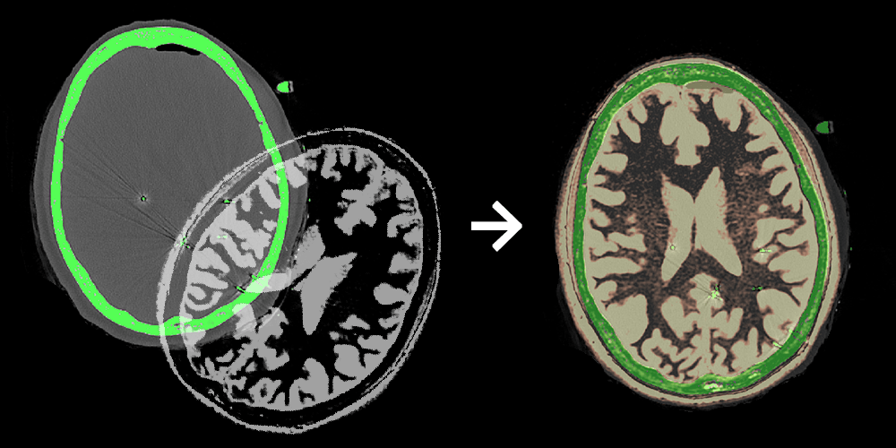
Image Registration
Image Registration is the process of aligning two or more images to a single coordinate system to compare information across scans, time, or modalities.
This process uses the same transformations we have seen before (i.e. rotation/translate, scale, affine, perspective) but may be restricted to certain types based on the data that is being analyzed.
Just like in the four-point algorithm, known markers are usually identified to find the optimal warp from source to target location.
https://3dqlab.stanford.edu/image-registration/

Slide 26
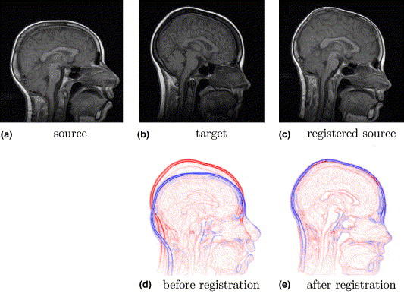
Image Registration
https://www.sciencedirect.com/science/article/abs/pii/S1361841505000459

Slide 27
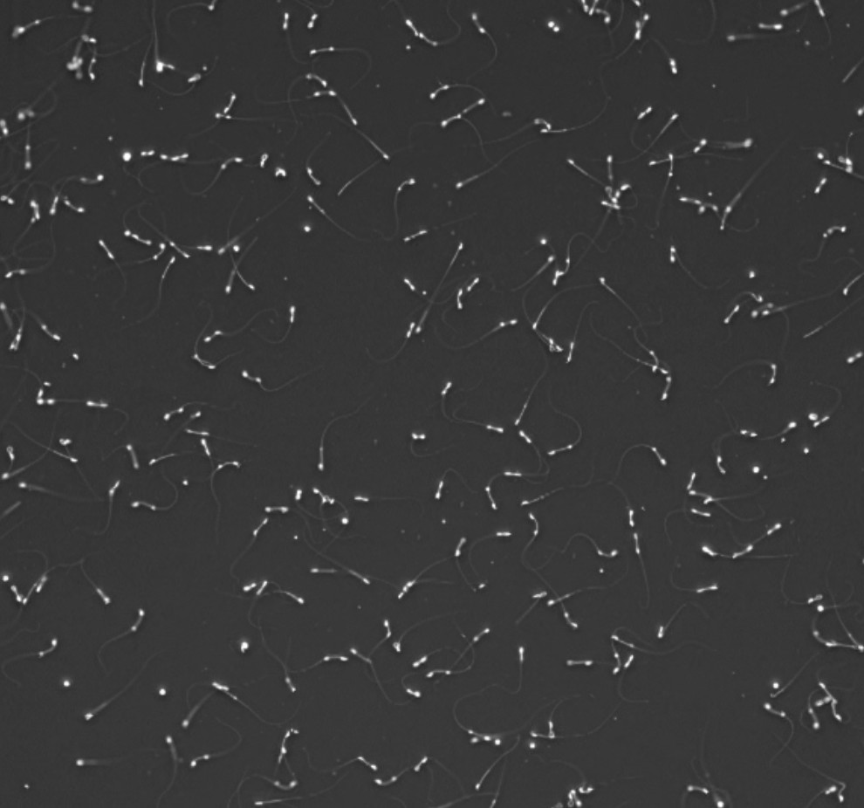
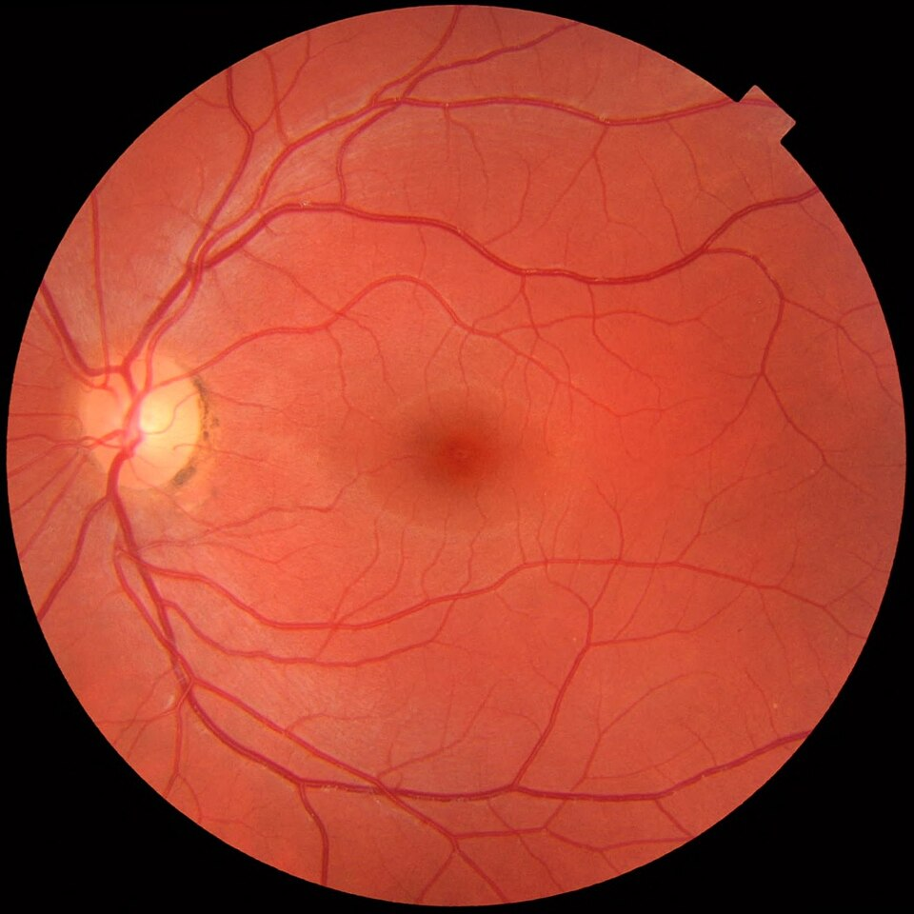
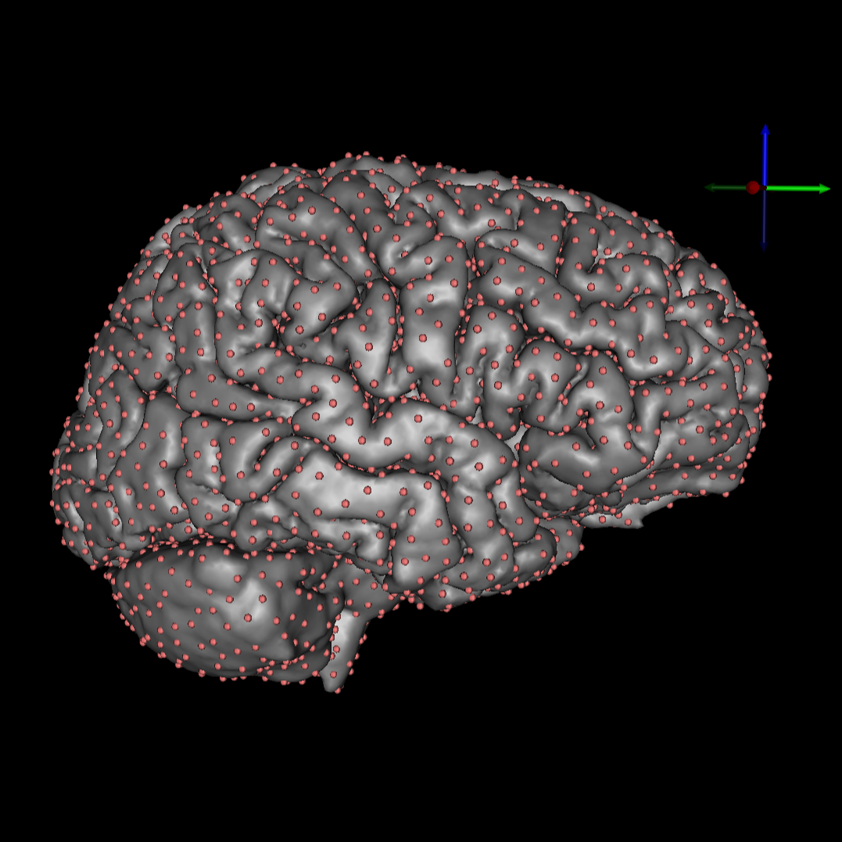
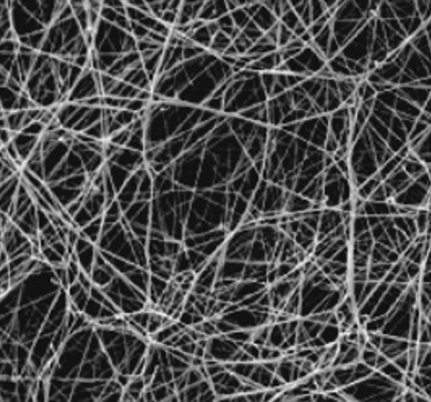
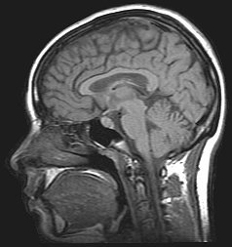
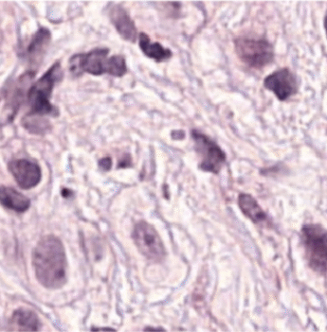
Projects Dr. Hart has worked on
Sperm Microscopy
Oculomics
EEG Source Localization
Blood Clot Formation
MRI for Speech Pathology
Breast Cancer Histology

Slide 28
Collaborators
Sperm Microscopy: Dr. Cameron Schmidt, Dr. Martin Bier
Blood Clot Formation: Dr. Nathan Hudson, Dr. Brittany Bannish, Dr. Martin Guthold
Oculomics: Dr. Ann Ostrovsky, Dr. Jessica Cooke-Bailey, Dr. Ashley Burch, Dr. Paul Bolin
MRI for Speech Pathology: Dr. Jamie Perry
EEG Source Localization: Dr. Moritz Dannhauer
Breast Cancer Histology: Dr. Nic Herndon, Dr. Joseph Geradts

Slide 29
Where is this heading?
There are a lot of use-case specific filters and operations that we didn’t get to cover (e.g. Frangi Filter for thin vessel segmentation).
Additionally, medical imaging is continuing to use more AI-based approaches to analyze structures and pick up on patterns.
More on this later…

